Slide 1
Playing Time of 2019 vs 2020
Eduardo Hernandez
Violet Numoto

Slide 2
Background: Eduardo
I have a wide range of experience in customer service, such as working in auto loans and life insurance. As well working in the hospitality industry as a night audit/front desk
I currently work as an office administrator for a cleaning company. My role includes helping organizing routes, getting supplies, and contacting clients to administrating payments
What encouraged me to pursuit data science was the understanding of what data really means. To be able to collect information and have knowledge of how to use it to reflect and help make changes for a company.

Slide 3
Background: Violet
I previously worked roles in construction project management, coordinating, operations, logistics, and social media marketing.
I first learned of the true power of data analysis and why it was essential to use as well learn it for myself while running campaigns. There where many times I had gotten a significant amount of raw data that was overwhelming until one of my analysis partners would transform it into useful information.
I wanted to learn more about the field and pursue an education in it to get into a project management or community relations role in a tech company and knew that having a background in data analysis would only help me perform at any company better.

Slide 4
Play Time of 2019 vs. 2020 - Overview
Covid
Steam
Question
Method
What Changed
Ratings
How Time of Play Changed

Slide 5

Covid-19
In December 31 2019, there was the first reported cases of a related pneumonia virus in Wuhan China
January 21st was confirmed of its first case in US and then in January 30th it was reported for the first person-to-person transmission of the Covid-19
March 11 it was declared as a global pandemic
During March 1st to May 31st, 42 states and territory issued an mandatory stay-at-home orders
In March 13, President Trump declared Covid-19 as National Emergency

Slide 6

Steam
Is a video game digital distributor made by Valve. Which was launched in September 2003
The biggest distributor platform for PC, taking 75% of the market sales for PC in 2013
It’s used as a cloud-based gaming library allowing users to store large amount of collections of games without taking space in their computers

Slide 7
Question
How has Covid-19 effected PC gaming from 2019 to 2020?
Has the playing time increased, decreased or stayed the same?
Has the game ratings been affected ?

Slide 8
Method
Eduardo:
Used Python to extract data and did data cleaning by dropping blank or not useful columns. Merged both 2019 and 2020 datasets. Created new variables and recoded data.
Also used Tableau to be able to graph and to show a representation of the data
Violet:
Used Python to extract the data and cleaned it by pulling the information using beautiful soup from the steam store.

Slide 9
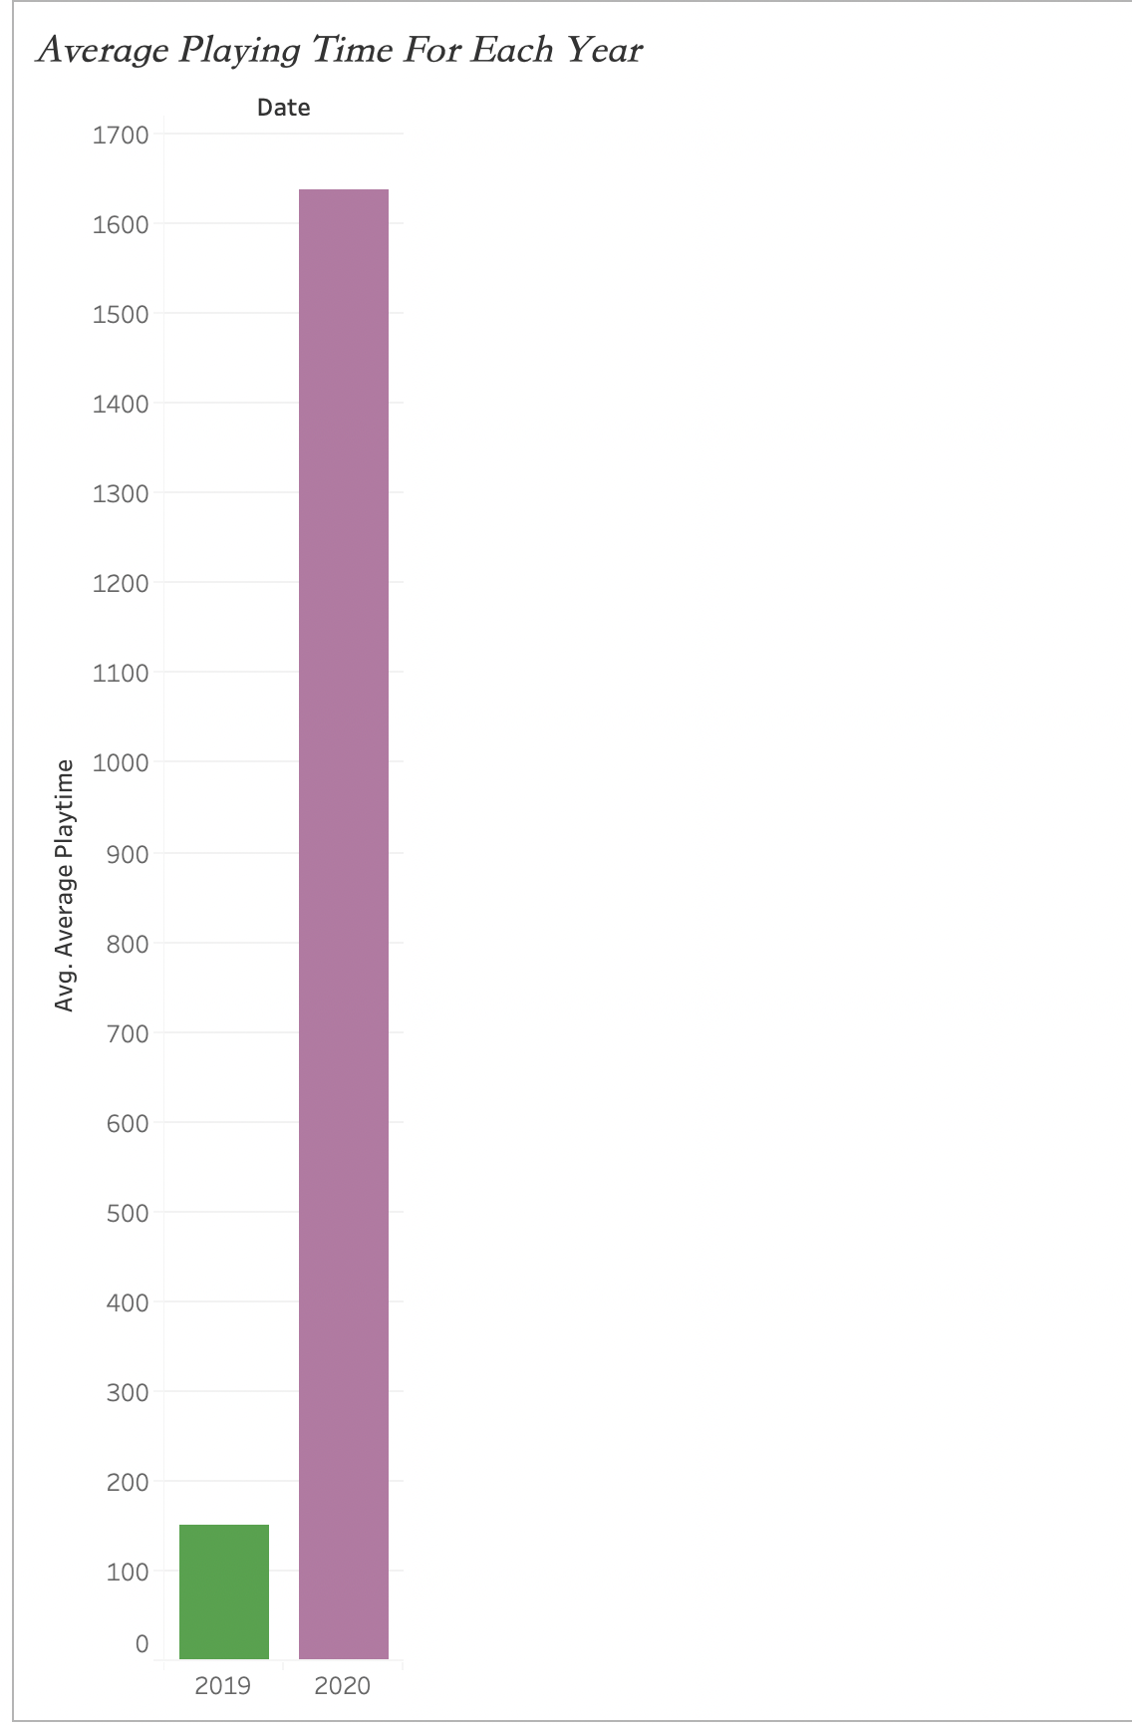

Most states had stay-at-home orders that was implemented between March to May of 2020 due to everyone being at home there was a leap in gaming hours.
In June of 2019, the average playing time is of 152 minutes (2.53 hours).
By December of 2020 its average playing time is 1,638 minutes (27.3 hours).
The Leap in Playtime

Slide 10
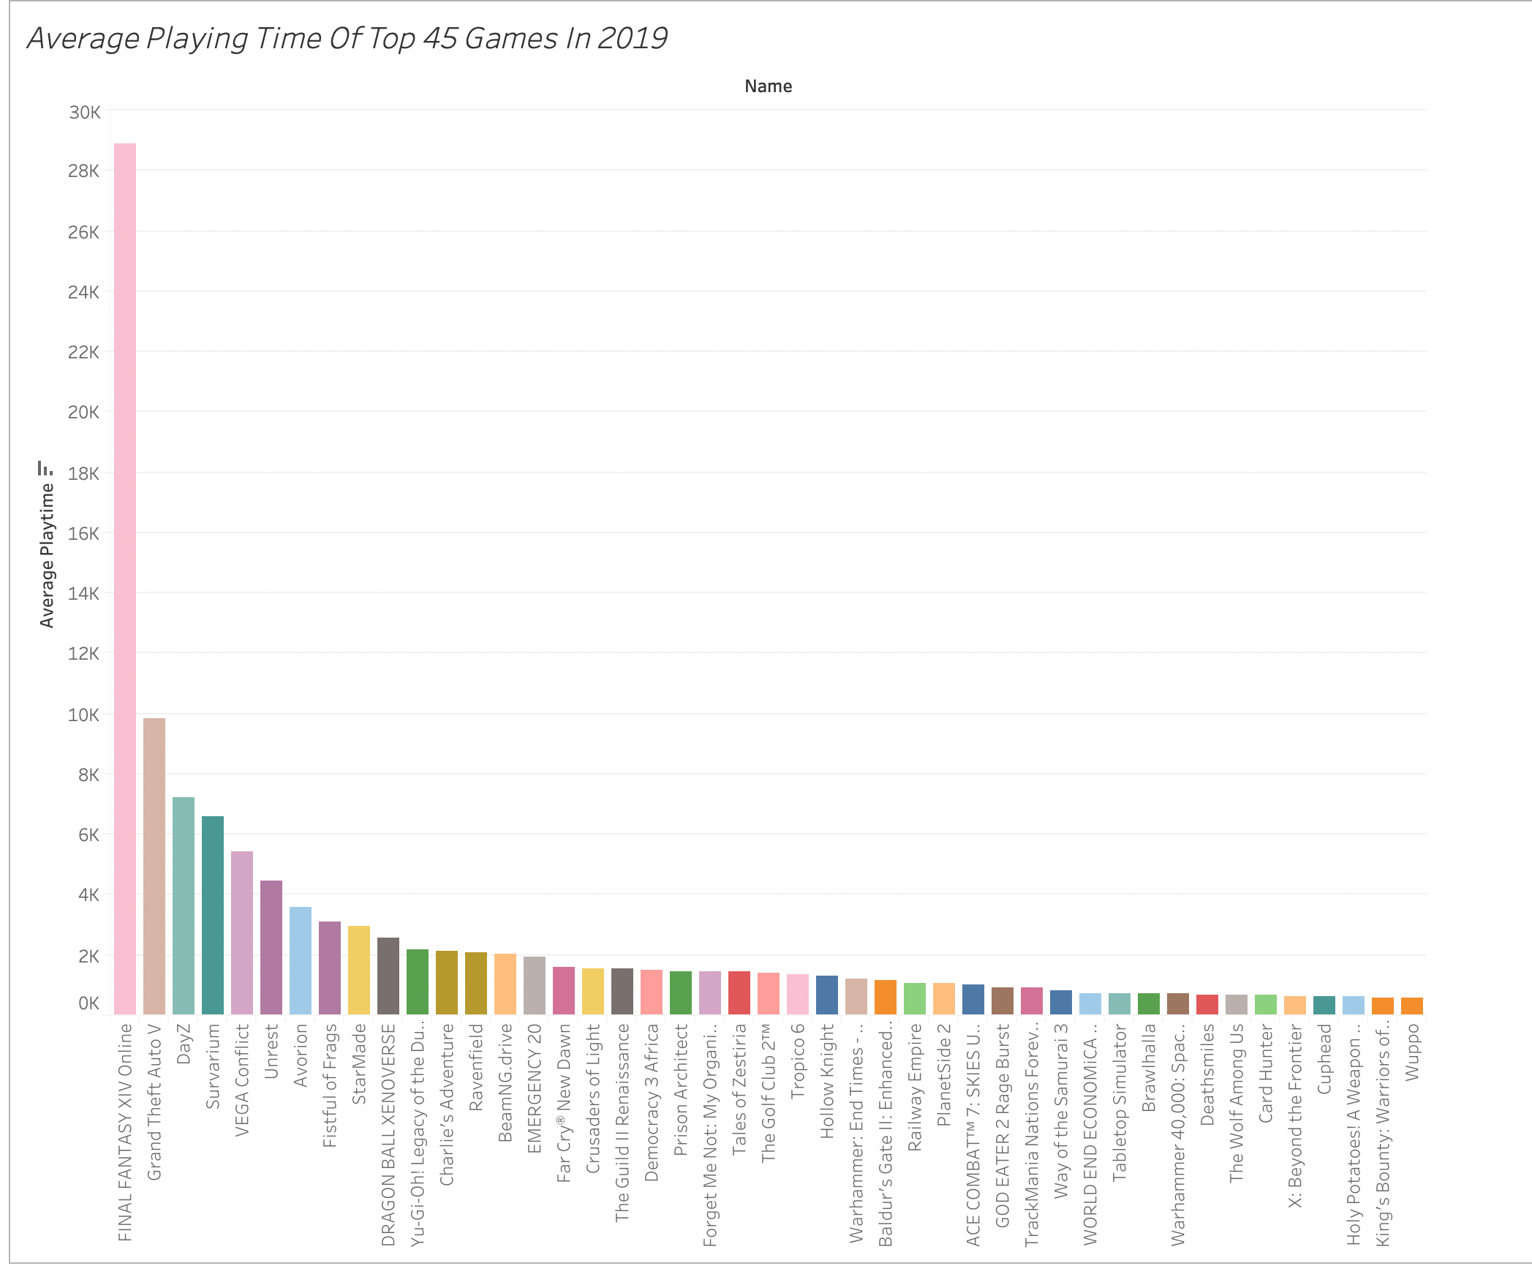

Slide 11
Top 45 average playing time in 2019
The top 3 games that had the most average playing time is Final Fantasy XIV, Grand Theft Auto V, and Dayz
With Final Fantasy XIV having an average playing time of 28,897 minutes (481. 62 hours), for Grand Theft Auto was for 9,837 minutes (163.95 hours), and Dayz was for 7,235 minutes (120.58 hours)
This data is reflecting since January to June 2019

Slide 12
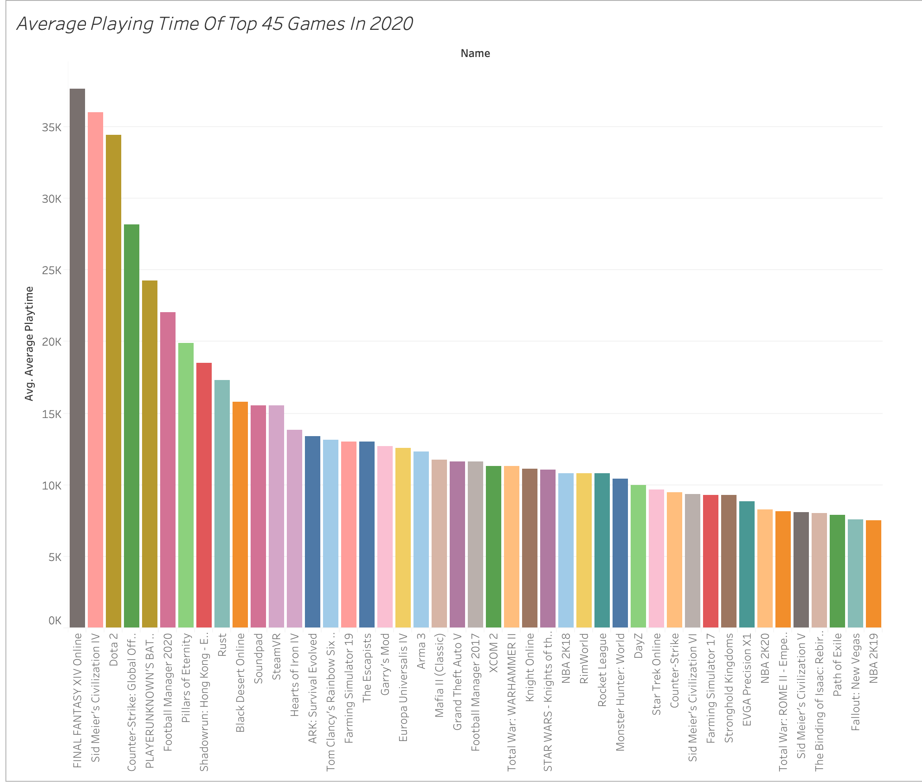

Slide 13
Top 45 Average Playing Time in 2020
In 2020 there is a major increase of average playing time.
With 2020 having its top 3 games, Final Fantasy XIV, Sid Meier’s Civilization IV, and Dota 2
Final Fantasy XIV has an average playing time of 37,667 minutes (627.78 hours), Sid Meier’s Civilization IV 36,020 minutes (600.33 hours), and with Dota 2 of 34,407 minutes (573. hours)
This data is reflecting from January to December 2020

Slide 14
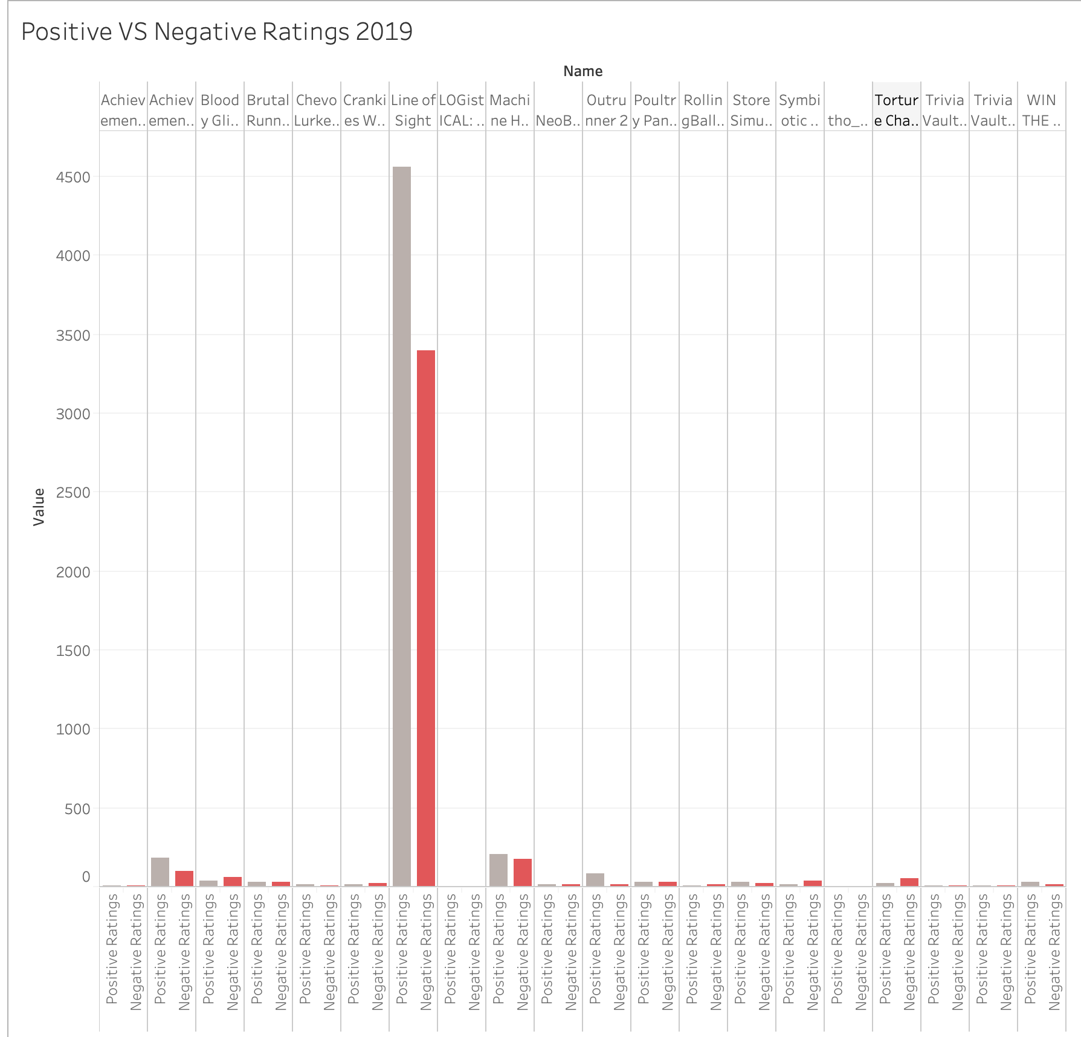

Slide 15
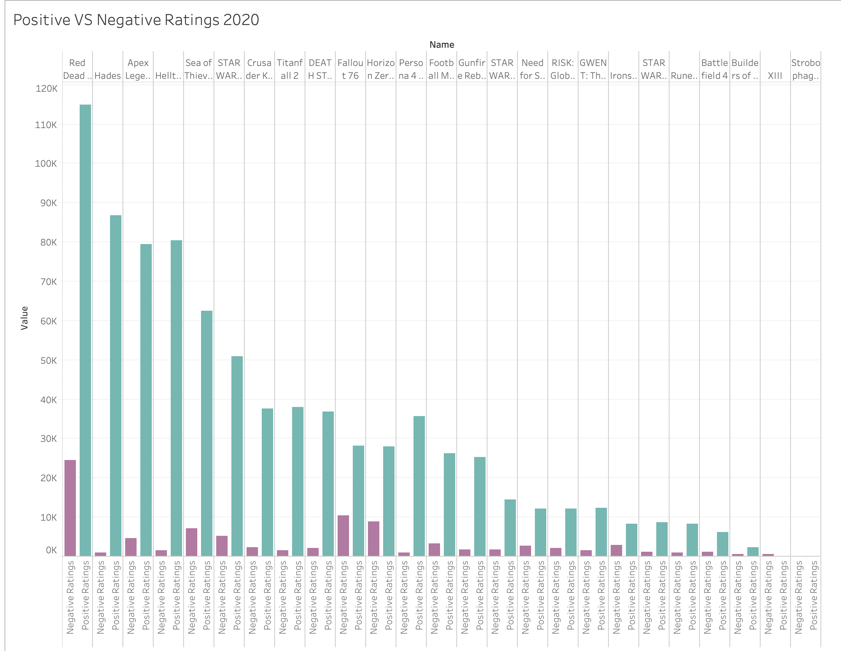

Slide 16
Positive VS Negative Ratings in 2019 and 2020
Players invested more time on reflecting on rating the games. In 2020, it can be seen more players will rate the games and shows more positive ratings than in 2019, gamers wouldn’t invest much time to rate them.

Slide 17
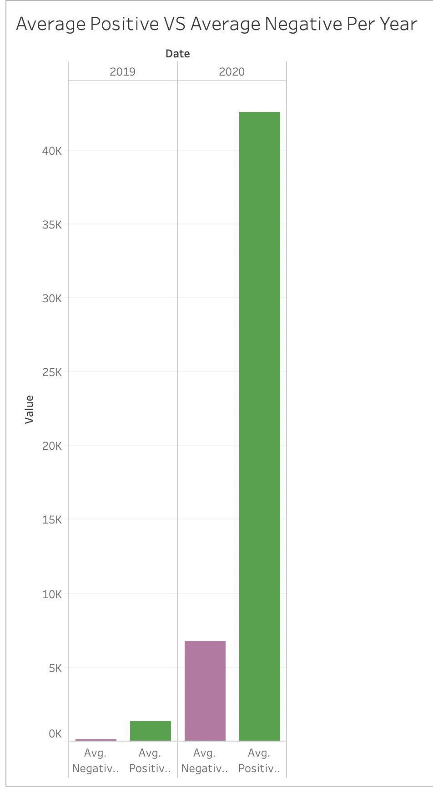
The Average Number of Rating for 2019 and 2020
In 2019 the average Positive rating was 1,369 versus having 127 Negative ratings
Then in 2020, its average Positive rating was for 42,589 versus 6,748 Negative ratings

Slide 18
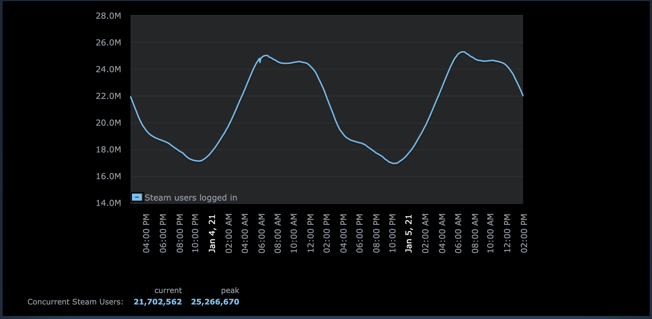
Gaming Time of Day

Slide 19
Current Players | Peak Today | Game
1001684.0 | 1047477.0 | Counter-Strike: Global Offensive
539134.0 | 635058.0 | Dota 2
151854.0 | 419119.0 | PLAYERUNKNOWN'S BATTLEGROUNDS
128289.0 | 153736.0 | Cyberpunk 2077
123167.0 | 159169.0 | Grand Theft Auto V
122605.0 | 134483.0 | Rust
113958.0 | 120579.0 | Source SDK Base 2013 Multiplayer
92275.0 | 110110.0 | Tom Clancy's Rainbow Six Siege
85850.0 | 104604.0 | Team Fortress 2
81990.0 | 102374.0 | Rocket League

Slide 20
Summary
In 2019, the average time of playing is much lower compared with 2020 by a difference of 1,486 min (24.77 hours).
Then for ratings , the difference between 2019 and 2020 of average positive ratings is 41,220. With the difference of negative ratings 6,621.

Slide 21
Conclusion
Every industry was affected in the year 2020 regarding of the pandemic of Covid-19. In Steam, it can be seen a rise of more people spending more time playing because of the stay-at-home order. Compared to the year of 2019, not only did the time of the playing time rise but also the investment of time taking place to give either positive or negative reviews.

Slide 22
Questions ?

